Slide 1
UC College of Medicine Center for Addiction Research (CAR)
Summer Speaker Series
Sponsored by: Center for Clinical & Translational Science & Training
June 12, 2024
12:00 – 1:00PM
This event is being recorded.
Participants can enable captions in the taskbar under more.

Slide 2
Center for Addiction Research (CAR)
The CAR was launched in October of 2020
Mission: to support cross-disciplinary collaborations across UC as well as with community partners, governmental institutions, and other academic institutions in order to accelerate scientific progress in addiction prevention and treatment
Twenty-nine faculty from six UC Colleges
CAR Website: https://med.uc.edu/institutes/CAR/home

Slide 3
CAR Website
Publications: https://med.uc.edu/institutes/CAR/publications
Projects:
https://med.uc.edu/institutes/CAR/projects
Communications:
https://med.uc.edu/institutes/CAR/communications
To become an affiliate member:
https://med.uc.edu/institutes/CAR/car-member-registration

Slide 4
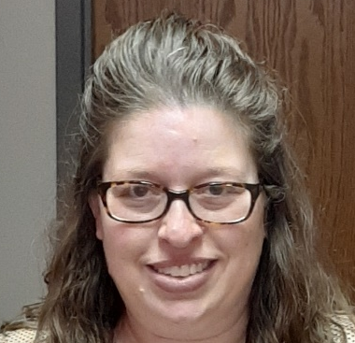
The COM CAR Summer Speaker Series
Supported by an award from the Center for Clinical & Translational Science & Training
Thank you to Jen Rowe for planning assistance.

Slide 5
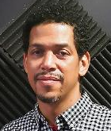
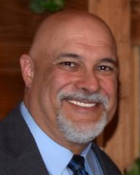
The COM CAR Summer Speaker Series
Special thank you for operational assistance from:
Jermaine Fields – UI/UX Lead, UC DTS Application & Software Development/ COM Web Development
Todd Schutter –Multi-Media Coordinator, UC DTS COM

Slide 6
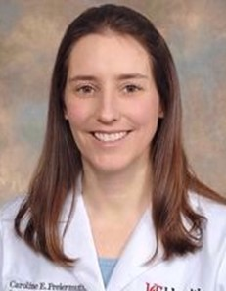
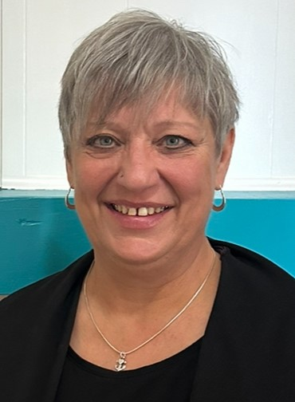
Risk Reduction in Human Trafficking and Substance Use Disorders: Bringing Education, Testing and Treatment to the Community
Caroline Freiermuth, MD, MHS
Shawn Ryan Endowed Chair for the Acute Treatment of Mental Health and Substance Use Disorders
University of Cincinnati
LeAnn Sanson
Weightless Anchor

Slide 7
Caroline Freiermuth, MD, MHS
Shawn Ryan Endowed Chair for the Acute Treatment of Mental Health and Substance Use Disorders
University of Cincinnati

Slide 8
Learning Objectives
Review risk factors for contracting infectious diseases such as HIV and hepatitis C.
Discuss impact of harm reduction initiatives such as testing for HIV and initiation of pre-exposure prophylaxis (PrEP).
Identify barriers to seeking out healthcare among certain populations.

Slide 9

Early Intervention Program
Founded in 1998
Mission: to identify and intervene with populations most at risk for threats to health and well-being at the earliest opportunity, and help these individuals connect with community resources to improve health outcomes.
Notes:
Started as a program to test for HIV- provide education, screening and linkage to care
Expanded over the years to include testing for hepatitis, other STIs, more recently SUD

Slide 10
Human Immunodeficiency Virus
Lentivirus
Present in bodily fluids
Infects T cells
Rapid reproduction cycle
Notes:
Blood, semen, vaginal fluids, anal fluids, breastmilk (not in urine or sweat- can’t get it from touching)
CD4 T cells preferentially affected- direct destruction, cleared by other cells
Reverse transcriptase- RNA to DNA

Slide 11
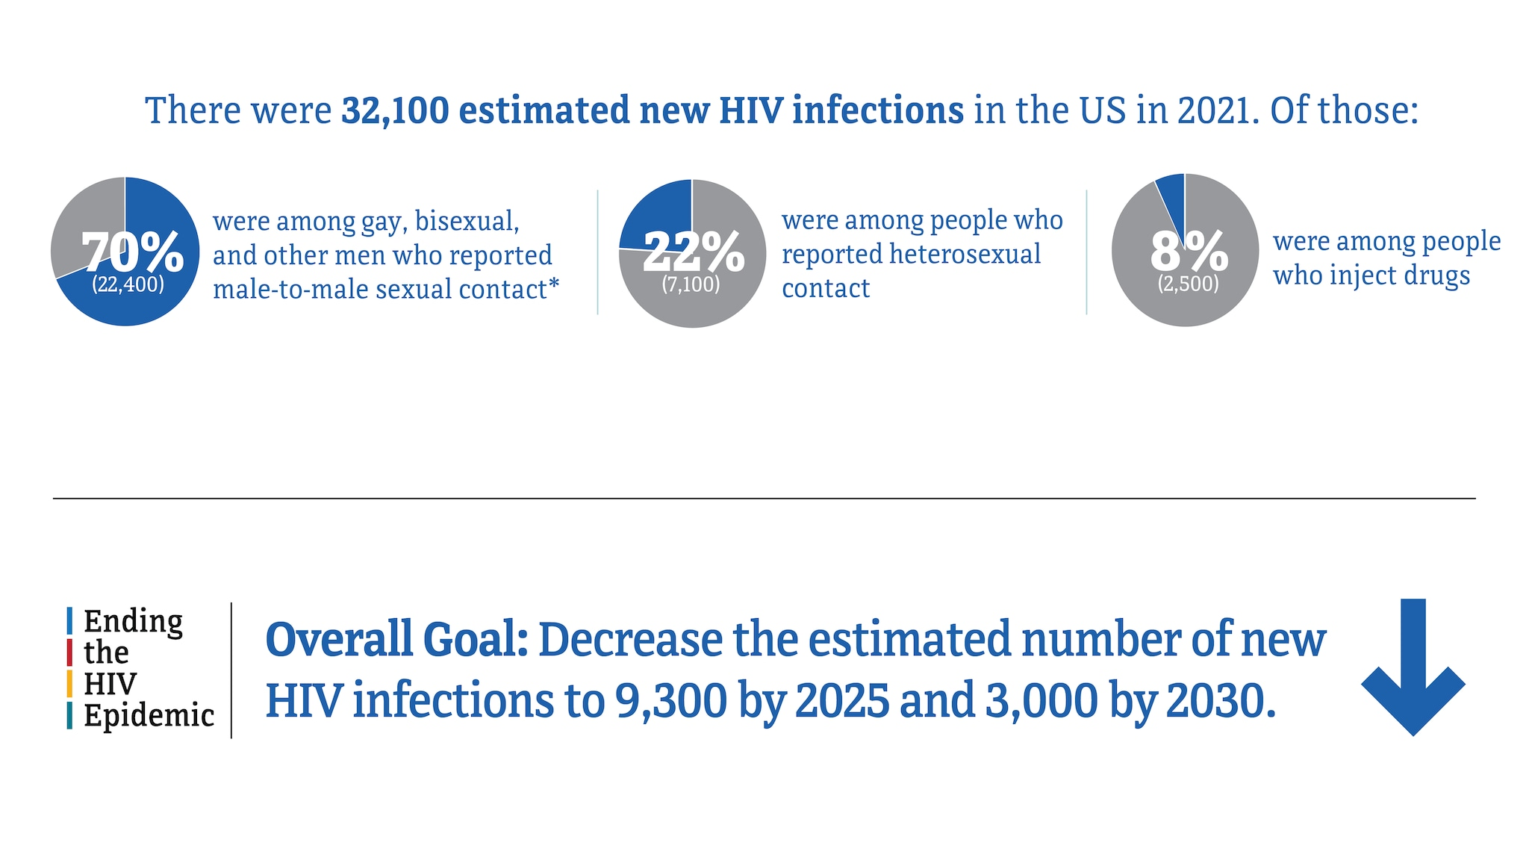
Risk Factors
CDC. Estimated HIV incidence and prevalence in the United States, 2017–2021. HIV Surveillance Supplemental Report, 2023; 28(3)
Notes:
CDC recommends everyone get tested at least once, all pregnant patients, anyone with multiple sexual partners, anyone sharing needles, infection with other STIs

Slide 12
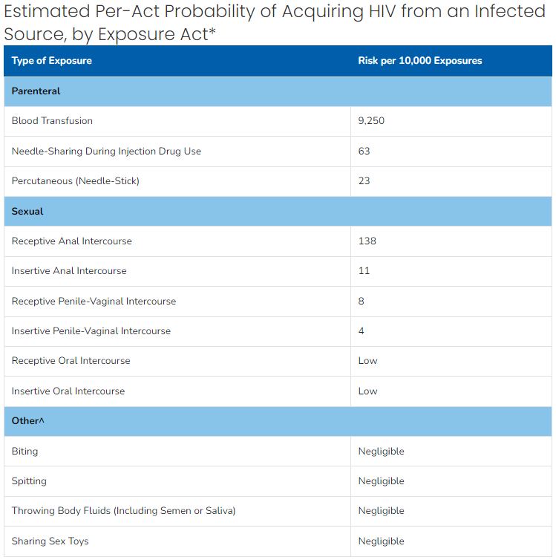
Testing
Patel P, Borkowf CB, Brooks JT. Et al. Estimating per-act HIV transmission risk: a systematic review. AIDS. 2014. doi: 10.1097/QAD.0000000000000298.

Slide 13
Treatment
Anti-Retrovirals
Chronic disease
  Life Expectancy after 2015 of adults with HIV on long-term antiretroviral therapy in Europe and North America: a collaborative analysis of cohort studies. The Lancet. HIV. May 2023
Notes:
You die with the disease, not from the disease

Slide 14
Hepatitis C
RNA virus
Mainly affects liver
Spread through contact with infected blood
50-80% develop chronic infection
  Increased risk of cancer
Notes:
Increased risk of transmission if you have HIV

Slide 15
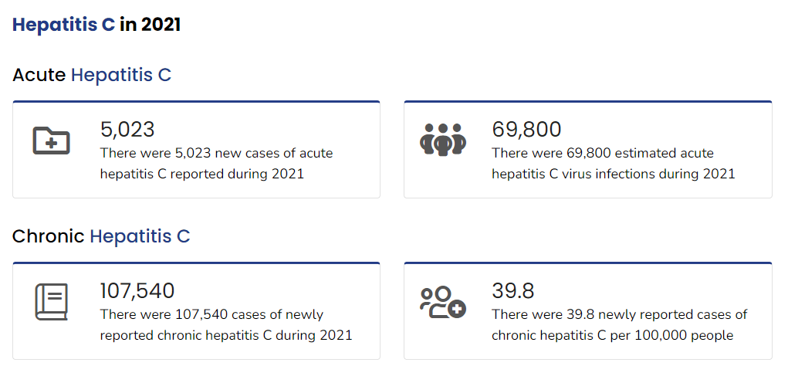
CDC Numbers
Body
Notes:
Cases doubled from 2014-2021

Slide 16
Treatment
Oral antiviral medication
  8-12 weeks
90-95% cure rate

Slide 17
Decreasing Spread
Get tested!
Safe sexual practices
Clean supplies for drug injection
Treatment
  Undetectable viral load= untransmissible
  U=U taking off in 2017. The Lancet. HIV.
PrEP
  Oral pre-exposure prophylaxis (PrEP) to prevent HIV: a systematic review and meta-analysis of clinical effectiveness, safety, adherence and risk compensation in all populations. BMJ Open. 2022

Slide 18
Barriers to Care
Access to testing
Stigma
Time
Cost
Low risk perception
Language

Slide 19
Early Intervention Program by the Numbers
Community partners- 9
HIV tests: 464 ED, 245 community
  Positive: 2
Hepatitis tests: 9903 ED, 55 community
  Positive: 238 ED, 1 community
Syphilis tests: 580 ED
  Positive: 17
Notes:
HIV is a swab, hepatitis is a blood test
Universal testing for hepatitis started Jan 2024

Slide 20

Resources
https://redcap.research.cchmc.org/surveys/?s=M77WEKECR7LM7477

Slide 21
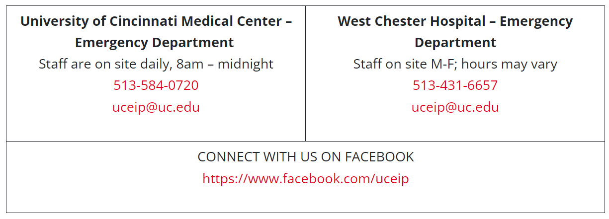
Contact Info

Slide 22
LeAnn Sanson
Weightless Anchor

Slide 23

Weightless Anchor
Founded in 2012
Daytime hospitality home, located in East Price Hill, that serves women stuck in the cycle of sex trafficking and drug abuse. We offer free laundry, showers, hot meals, clothing, hygiene items, and most importantly love without a price

Slide 24
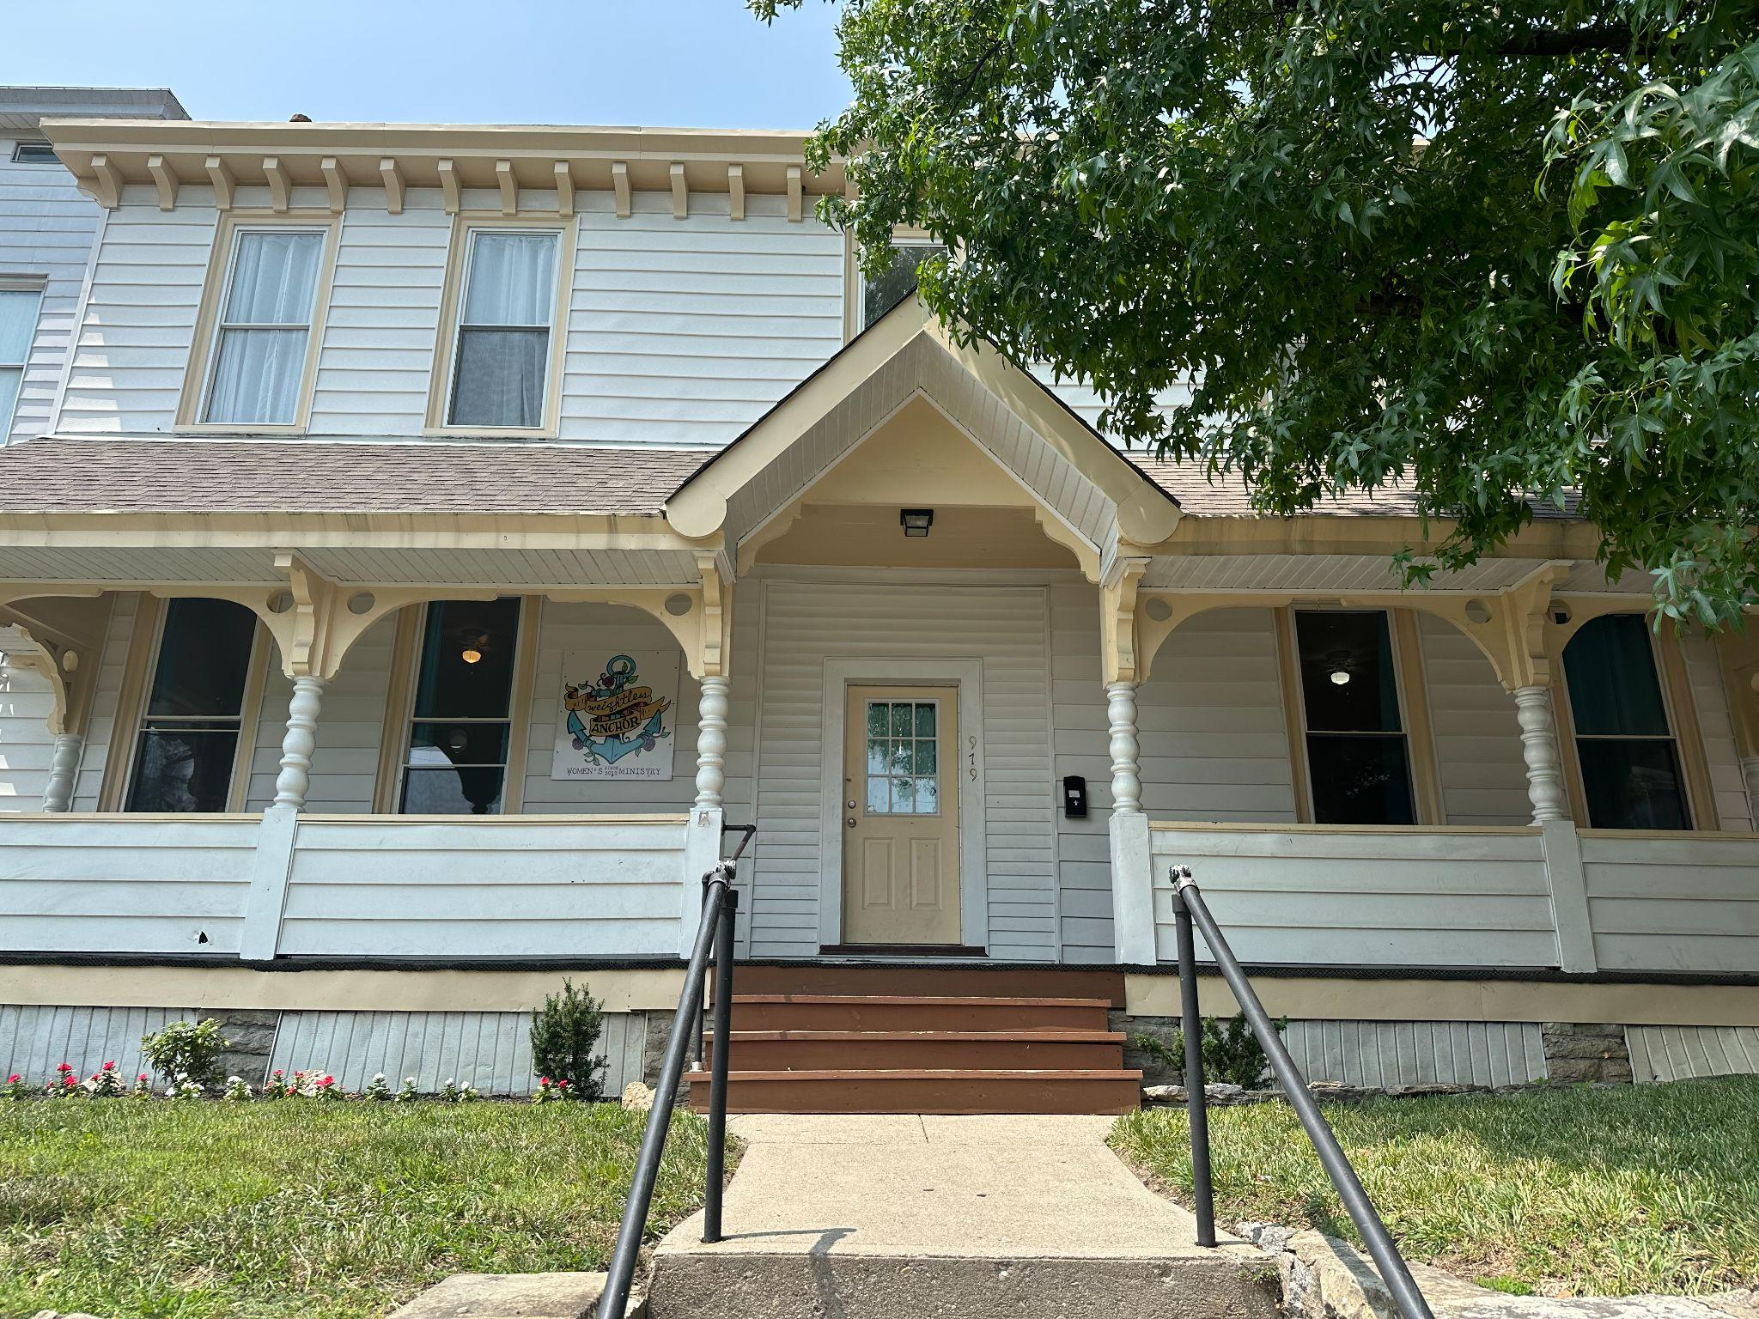
Weightless Anchor, Bloc Ministries

Slide 25

Nap/TV Room

Slide 26
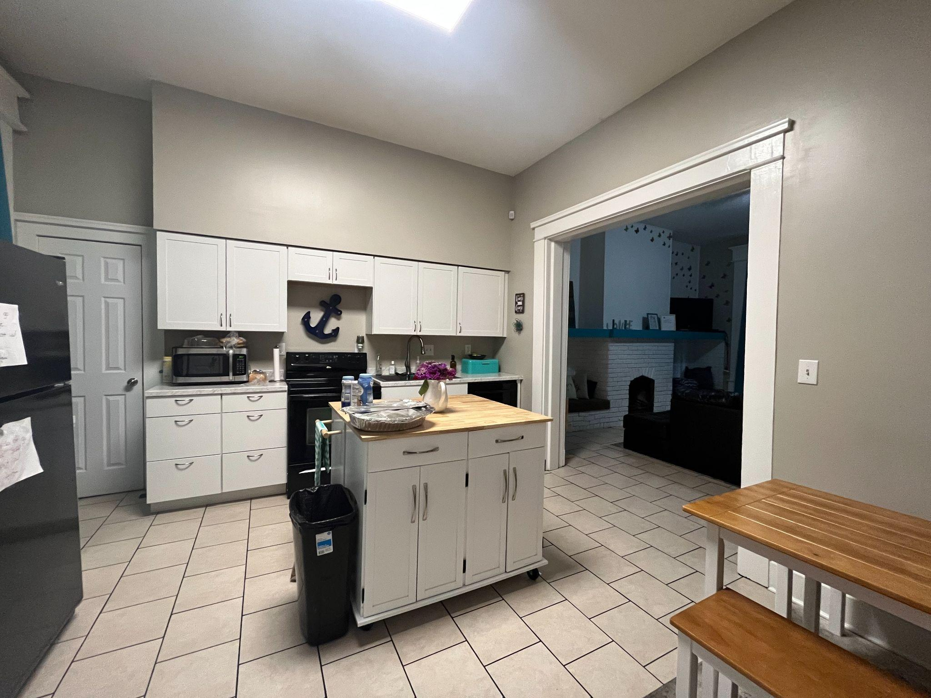
Kitchen

Slide 27
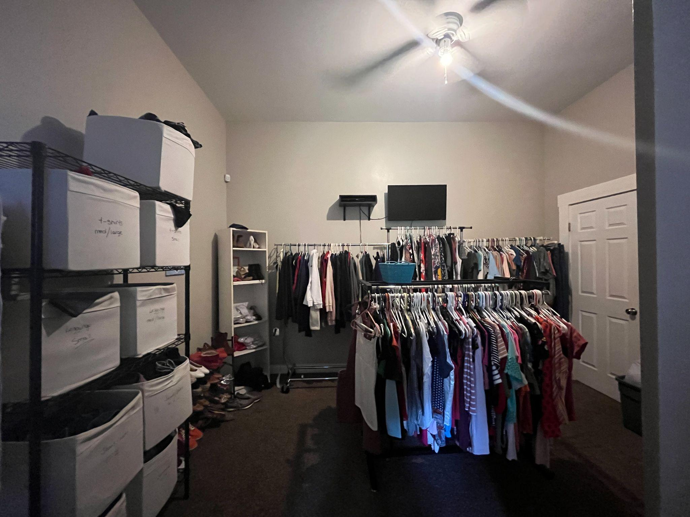
Clothing Room/Shower Room

Slide 28
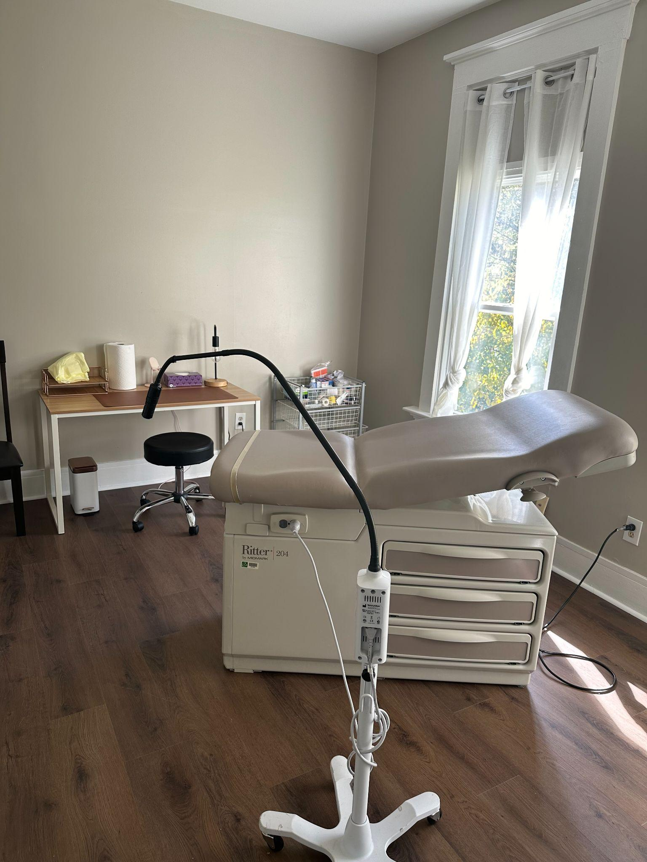
Wound Care Clinic

Slide 29
Human Trafficking
Impossible to truly measure the number affected
https://humantraffickinghotline.org/en/statistics

Slide 30
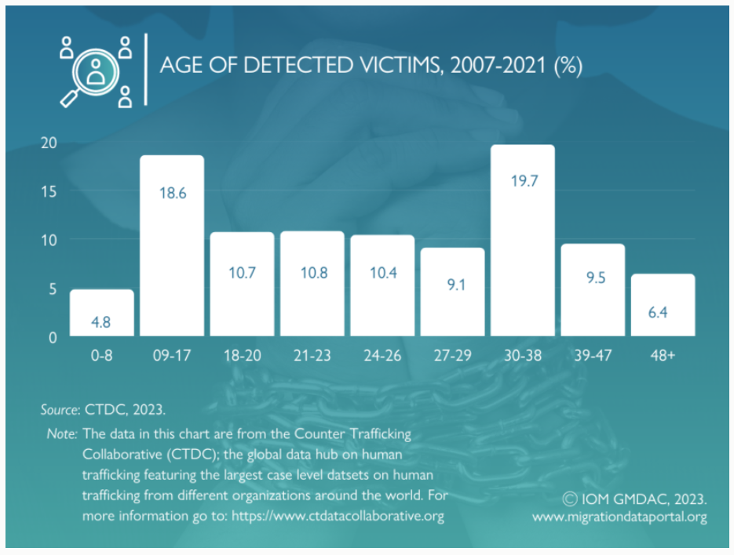

Slide 31
Contributing Factors to Contracting Infectious Diseases
Being unhoused
Addiction
Unknown partner status
Multiple partners
Inability to maintain proper hygiene
Access to safe use/harm reduction products
Sharing drug use instruments

Slide 32
Barriers to seeking health care
Shame
Judgement (perceived and experienced)
Health care staff thinks they are drug seeking
Long waits
Fear of detox
Due to long term intravenous drug use, IVs are difficult and painful to establish
Lack of empathy from health care providers
Anxiety
Fear of being reported to judicial authorities
Low dosing of MAT medication

Slide 33
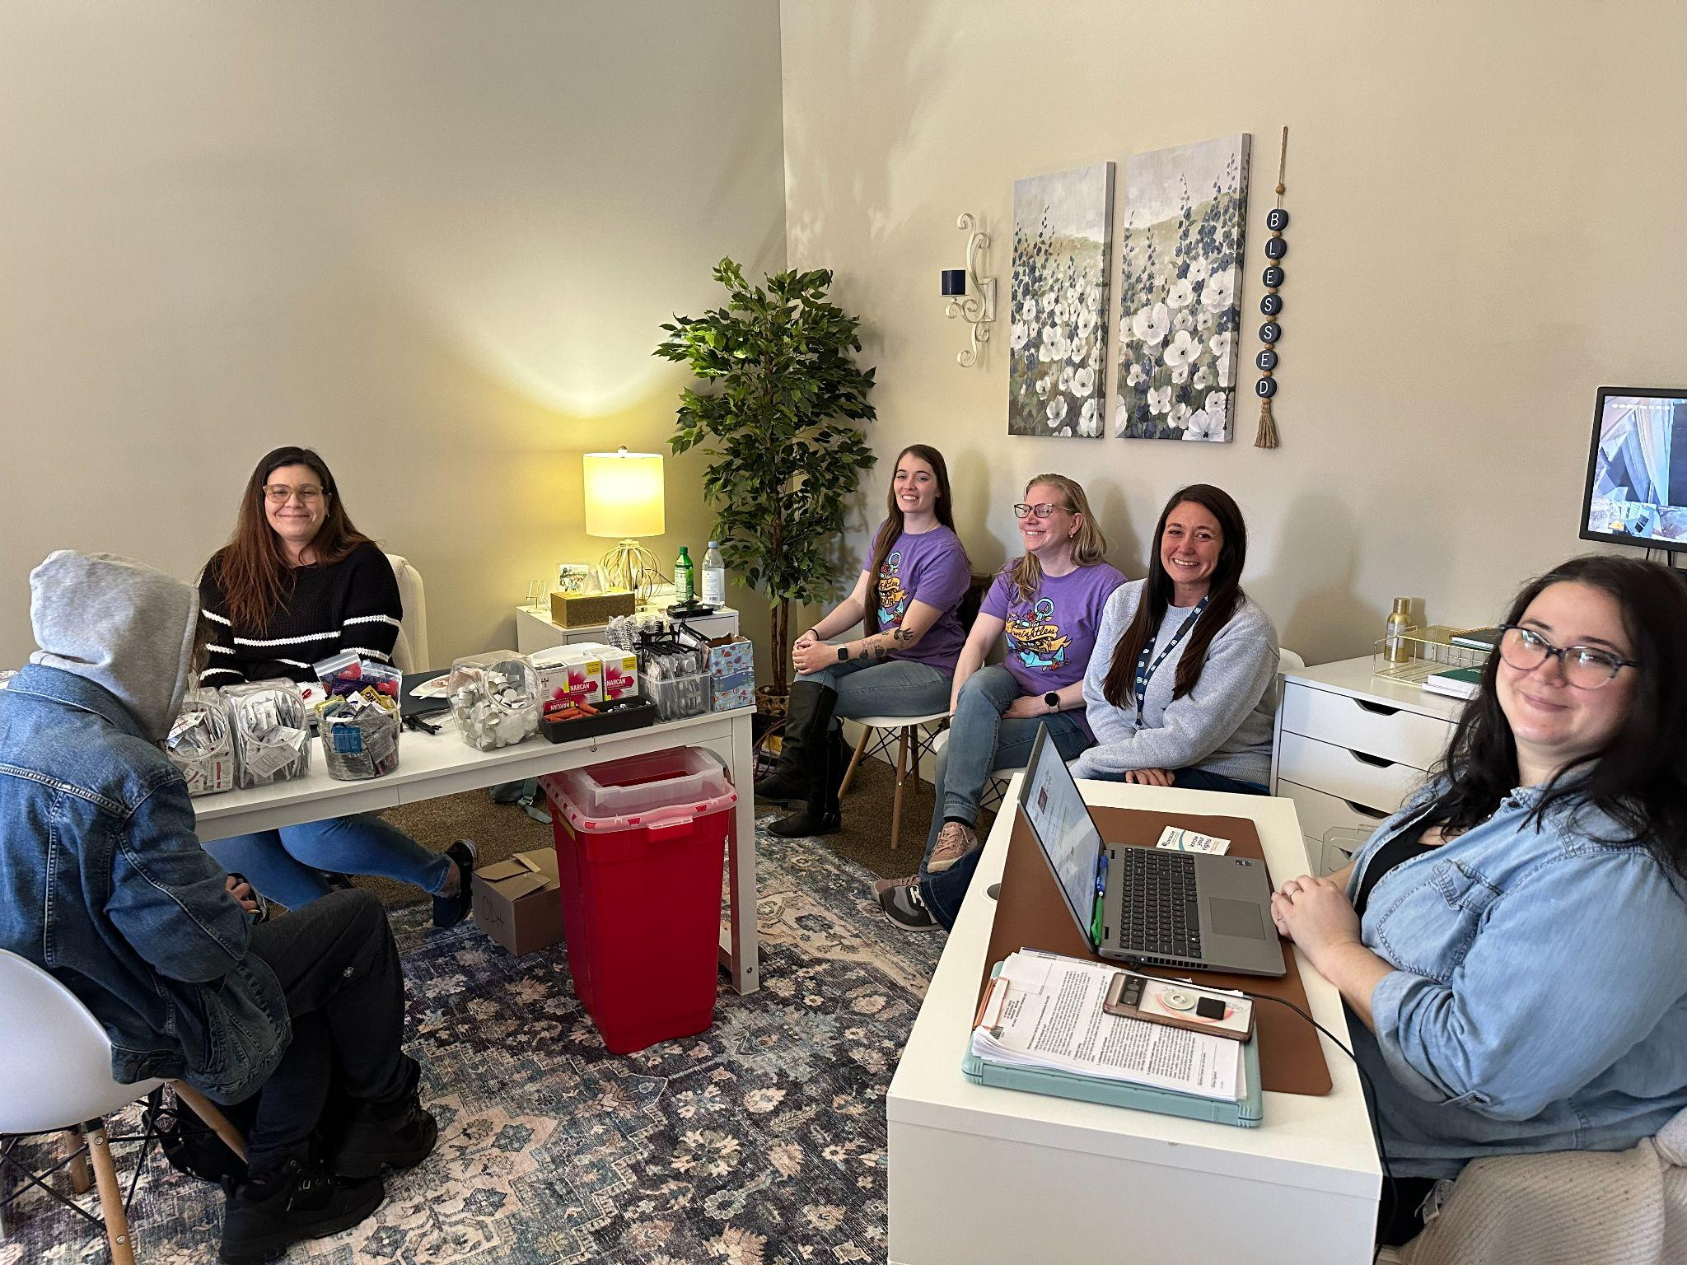
Community Links Partnership

Slide 34
Partnership with the Early Intervention Program
Once weekly for a few hours
Testing for HIV and Hep C with linkage to care
Risk assessments
  Education
  Harm reduction referrals

Slide 35
Q&A
Please unmute to ask a question OR type your question in the chat box.

Slide 36

Thank you for joining us!
Please take a few moments to complete
the survey form. Scan the QR code below or use the survey link provided in the chat box, both will be emailed.
The form is required to complete if requesting CE credit for Psychology, Social Work, or Counseling.

Slide 37


A Unique, Co-Designed Family-Based Therapy for Marginalized Women with Opioid Use Disorder and Justice-Involvement
Wednesday, July 10, 2024: 12:00 – 1:00 PM
Dr. Aaron Murnan and Gwen England
Registration website: med.uc.edu/institutes/CAR/summer-speaker-series/speaker-series-2024

