Slide 1
Generic Antiepileptic Drugs: Facts, Fiction and Lessons for Epilepsy Treatment
Michael Privitera, MD
Professor Neurology
Director Epilepsy Center
University of Cincinnati Neuroscience Institute

Slide 2
Disclosure: Michael Privitera, M.D.
Research Support / Grants
UCB, Eisai, Neuren Pharma;
EQUIGEN: FDA, American Epilepsy Society, Epilepsy Foundation
Other
DSMB: Astellas, Upsher Smith

Slide 3
Background on the Controversy
Every day several million tablets of generic AEDs are taken by people with epilepsy
Generic drugs can be an important weapon to combat health care costs
FDA estimated $56.7 billion per year saved in 2002 by generic substitution
Advocacy groups: indiscriminate generic substitution in people with epilepsy can cause problems because FDA rules allow too much variability across formulations
FDA: it has no reliable documentation of generics causing problems and formulations are interchangeable without additional testing

Slide 4
Literature is Full of Retrospective Studies Highlighting Generic Risks (or not…)
Physician surveys- 50% of responders saw problems
Case series follow up from survey- random blood levels (Berg 2008)
Generic switches associated with high switchback rate and higher costs in Canada (Andermann 2007)
Generic use associated with higher emergency services use (Zachry 2008)
No effect of generic use on epilepsy related events (Devine 2010)

Slide 5
Summary of Generic Background Issues
Criticisms of FDA testing
Not on people with epilepsy
Single dose
No concomitant meds
No seizure or adverse event outcomes
Same rules for any drug—ignores narrow therapeutic index drug differences. FDA advisory committee suggests changing this and definition is forthcoming
Criticisms of Anti-generic literature
Uncontrolled
Retrospective
No rigorous blood levels

Slide 6
Does Funding Source Make a Difference? A sampling of 156 articles…
Study | Result | Funding | Study | Result | Funding
Switchback | Generic worse |  | ER and MD Visits | No difference
ER & MD Visits | Generic worse |  | Phenytoin & Seizures | No difference
Breakthrough seizures | Generic worse |  | Systematic Analysis | No difference
Adverse effects and sz | Generic worse |  | AED problems | No difference

Slide 7
Does Funding Source Make a Difference? A sampling of 156 articles…
Study | Result | Funding | Study | Result | Funding
Switchback | Generic worse | Pharma | ER and MD Visits | No difference | Mgd Care
ER & MD Visits | Generic worse | Pharma | Phenytoin & Seizures | No difference | Mgd Care
Breakthrough seizures | Generic worse | COI with Pharma | Systematic Analysis | No difference | Mdg Care
Adverse effects and sz | Generic worse | COI with Pharma | AED problems | No difference | Mgd Care

Slide 8
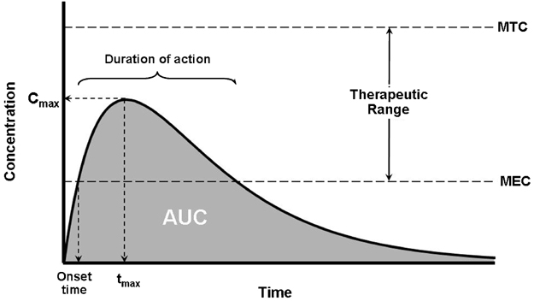
*for multiple dosing, Cmin variations
may have a clinical effect

Slide 9
FDA Sets “Goalposts” for Generics at 80-125%
80
125

Slide 10
Compare the Two Most Disparate Generics
80
125
83
90
105
122

Slide 11
Generic Products for Testing Are Close to Reference
 | AUC CI
Theoretical Low | 83-90
Low Generic 1 | 95.5-101.4
Theoretical High | 105-122
High Generic 1 | 102.0-113.8

Slide 13
EQUIGEN-Chronic Dose STUDY
12 hr
PK: 19 levels
12 hr
PK
12 hr
PK
12 hr
PK
randomization
2 wk
2 wk
2 wk
2 wk
2 wk
MEMS
Baseline
compliance
Low
Generic
High
Generic
Low
Generic
High
Generic
Two levels to assure steady state

Slide 14
EQUIGEN Chronic Study: Methods
Must be on “balanced” dosing of lamotrigine (100 bid, 200 bid, 300 bid, or 400 bid)
Many compliance measures
Tablet counts
Medication diaries
MEMS caps: microchip measures each time medicine bottle is opened
For the 3 days before PK, all doses taken within an hour of scheduled time; no missed doses for the week before

Slide 15
EQUIGEN Chronic Dose Study: Methods
In contrast to prior research EQUIGEN subjects:
Had epilepsy
Were often receiving concomitant medications with potential drug–drug interactions
Were receiving daily dosing (not single doses)
Underwent rigorous adherence monitoring through diaries and electronic methods
Underwent monitoring of adverse effects and seizure control.

Slide 16
EQUIGEN Chronic Dose Study: Results
33 subjects
58% were on polytherapy with other antiepileptic drugs, 18% had enzyme inducing drug-drug interactions with lamotrigine
Remarkable compliance:
132 completed treatment periods with 3696 doses
Only 11 instances of minor compliance violations (single late or missed doses) leading to a makeup period.
No loss of seizure control
No unexpected adverse effects and standardized side effect measure scores were not different between generics

Slide 17
EQUIGEN Chronic Dose Study: Results
No outlier subjects for Cmax or AUC
Cmax:
“high” generic 5.03
“low” generic 4.96
90%CI: 99-105%
AUC:
“high” generic 2722
“low” generic 2710
90%CI: 98-103%

Slide 18
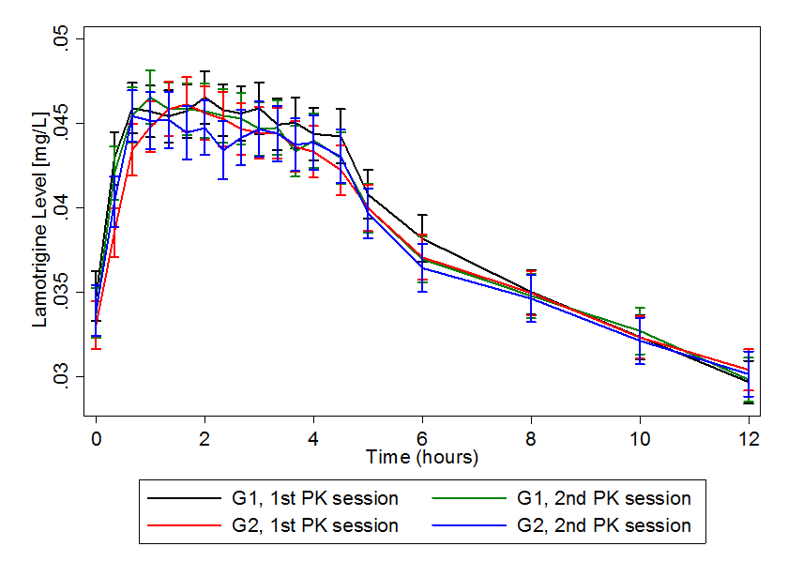
Chronic Dose Study:
No Significant Difference Cmax
Dose Normalized 200 mg BID

Slide 19
randomization
EQUIGEN-single dose STUDY
96 hr
PK
96 hr
PK
96 hr
PK
96 hr
PK
96 hr
PK
96 hr
PK
2 wk
2 wk
2 wk
2 wk
2 wk
washout
washout
washout
washout
washout
Brand
1 dose
High
Generic
1 dose
Low
Generic
1 dose
Brand
1 dose
Low
Generic
1 dose
High
Generic
1 dose
FINAL PROTOCOL

Slide 20
EQUIGEN Studies: Conclusions
We found no deviation from FDA bioequivalence standards in Cmax and AUC comparing the two most disparate generics in a chronic dosing study, in a single dose study and our findings were replicated by another group Teva vs brand in chronic dosing study
No difference inducers vs no inducers
Chronic dosing generic equivalence trials are feasible and compliance is excellent
Then why so many problems reported?
Nocebo effect
Attributing spontaneous seizures to generics
Pill color confusion

Slide 21
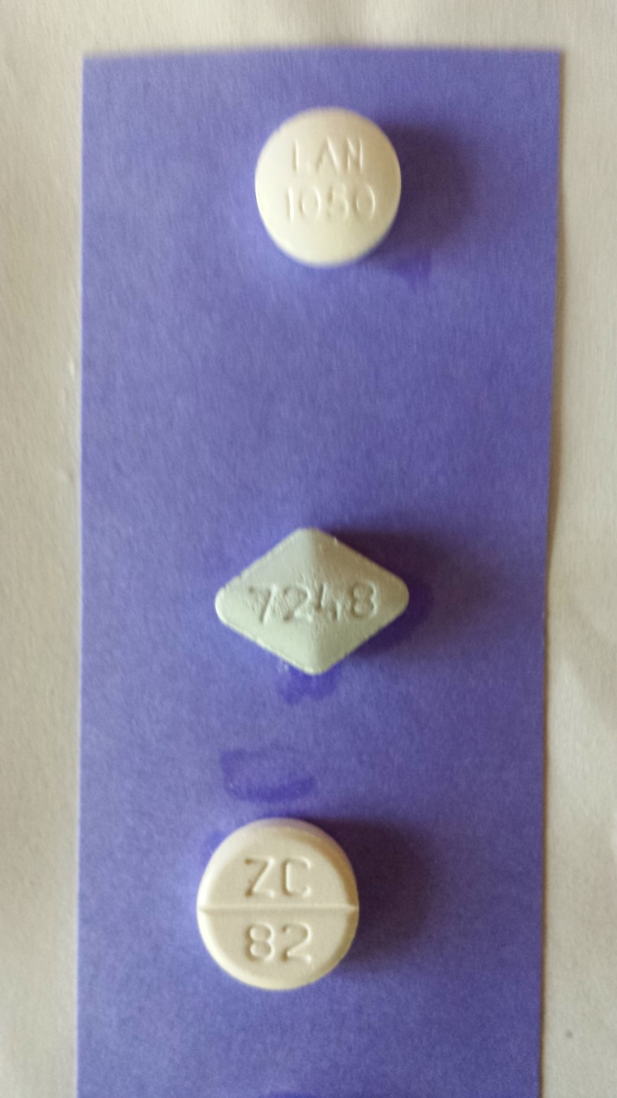
It’s Easy to Confuse Generic Tablets…

Slide 22
Generic Antiepileptic Drug Equivalence: The EQUIGEN Trial
Study Team
Michel Berg, MD (Co-PI)
Timothy Welty, Pharm D
Barry Gidal, Pharm D
Francisco Diaz, PhD
Jerzy Szaflarski, MD, PhD
Barbara Dworetzky, MD
Lebron Paige, MD
John Pollard, MD

Slide 23
Seizures and Stress: What it Means, How to Block the Connection
Michael Privitera, MD
Professor Neurology
Epilepsy Center
UC Neuroscience Institute

Slide 24
Seizures and Epilepsy: More Common Than You Think
About 2.2 million epilepsy cases in the US (lifetime 1 in 26 people)
Up to 30% will become medication resistant
Medication resistant epilepsy: Failed to become seizure free after adequate trials of two different antiepileptic drugs.

Slide 25
New Medications Have Not Made A Major Impact on Seizure Freedom
We’ve manipulated neurotransmitters, receptor targets, dozens of models of epilepsy, and decades of translational research:
16 new antiepileptic drugs, two devices since 1993
Each new drug costs about $1 Billion!
Average new antiepileptic drug makes only 2-3% seizure free
All new drugs have pros and cons
How about a different approach?
Stress modification
Seizure prediction

Slide 26
The sudden and apparently unpredictable nature of seizures is one of the most disabling aspects of the disorder epilepsy.

Slide 27
Stress is a Common Seizure Precipitant
Most people with epilepsy wonder “why did that seizure happen when it did?”
Stress is the most commonly reported precipitant by people with epilepsy
Up to 2/3 of people with epilepsy report stress as a precipitant in 6 different questionnaire studies

Slide 28
Seizure Precipitants Reported by People with Epilepsy in Diary Studies
Sleep deprivation
Menstruation
Medication noncompliance
Intercurrent illness
Alcohol
Stress and stressful life events

Slide 29
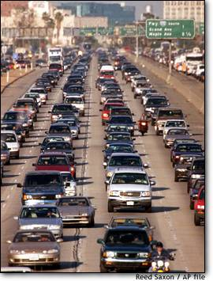
Stress: A real or perceived threat to health and/or well-being
Retirement Fund
30
20
Fund Balance
(thousands)
10
0
Notes:
Stress Intro-
-fairly benign and accepted definition
-experience of stress is largely self-generated and brain-built

Slide 30
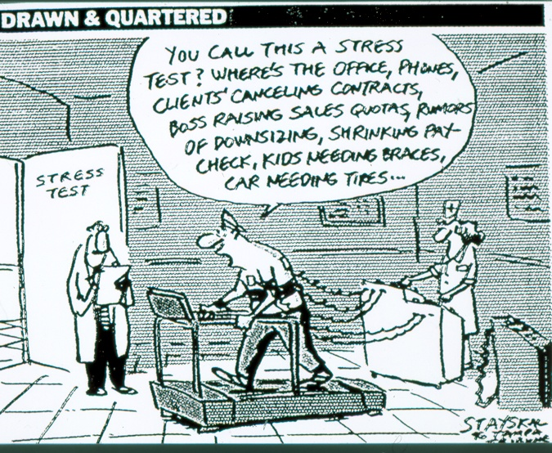

Slide 31
Seizure Threshold Complicates
Study of Triggers
SEIZURE
Seizure Threshold
Seizure Tendency
Missed
Meds
Stress
Alcohol
Stress
Alcohol
time

Slide 32
Rodent Data Indicates Interaction of HPA Axis & Seizures
Stress activates the hypothalamic-pituitary-adrenal axis producing glucocorticoid secretion
Systemic administration of glucocorticoids in rodents increases neuronal excitability and seizure frequency
O’Toole (2014) showed corticotropin releasing hormone antagonist blocked seizure activation in pilocarpine model

Slide 33
Some People With Epilepsy Can Predict Seizures (to a degree)
People with epilepsy filled out a diary every day and were asked “What’s the chance you will have a seizure in the next 24 hours?”
Seizure predictors: those people who could predict seizures better than chance
About 1 out of 5 were “predictors”
High stress self reported best predictor
Haut et al, Neurology 2007

Slide 34
Many People Can Tell When The Chance of a Seizure Is Higher

Slide 35
Characteristics of People Who Believe Stress Precipitates Seizures
Population: 266 sequential patients in our epilepsy center who either endorsed stress as seizure precipitant (n=219) or not (47).
Results: People said stress leading to seizures could be either chronic (wk-mo; 85%) or acute (hr-day; 68%)
Risk factors are depression or anxiety measured by NDDI-E and GAD7; only anxiety significant in multivariate analysis
Many people have tried stress reduction and 88% of those who tried believe it reduced seizures.
Analysis of same group with Childhood Trauma Questionnaire showed higher emotional abuse

Slide 36
A Stress Management Program for Patients with Multiple Sclerosis Prevented Development of New Brain Lesions
121 subjects; 16 sessions over 24 weeks
Wait list control
MRI scans showed 77% controls had new Gd enhancing lesions vs 55% of stress reduction
No difference once counseling stopped
First time counseling or psychotherapy prevented new brain lesions
Mohr D, Neurology 2012

Slide 37
Mindfulness Improved QOL in Seizures
Medication resistant epilepsy patients randomized to mindfulness or social support, single blind (could change meds)
4 sessions over 8 weeks
Primary Outcome: quality of life
Both groups improved; mindfulness significantly better in QOL, depression, anxiety, seizures
Class 2 evidence mindfulness improves QOL
Tang et al, Neurology 2015

Slide 38
SMILE Stress-Seizure Study
2 or more seizures/month
Stress or other trigger
Stable medication
Twice Daily Active Intervention
ACTIVE
Twice Daily
E-Diary
Twice Daily Control Intervention
CONTROL
Pre-Study Baseline
2 Months
3 Months

Slide 42
Seizure Occurred 4/13 after entry
3 Hours before seizure

Slide 43
Stress Management Intervention for Living with Epilepsy (SMILE)
Goal: Reduce seizures by blocking stress
Obtain additional data on seizure prediction
How: Stress reduction using non-medication treatment approach (muscle relaxation, diaphragmatic breathing, focused attention- practice twice daily)
Smartphone monitoring of stress and other triggers multiple times per day

Slide 44
SMILE: A Unique Study
First blinded randomized controlled trial of stress reduction in epilepsy
Interim analysis on 66/90 subjects : sham response higher than anticipated
Data from this study will help determine: stress reduction methods for next study(exercise, PMR, CBT; choice or pilot to predict most effective)
Establish sham response
Characteristics of responders (anxiety?)
First application of momentary analysis of mood and stress variables in epilepsy: surprisingly high compliance with diary entries
Largest data set for seizure prediction modeling

Slide 45
SMILE: Seizures Reduced in Both Active and Control Groups
67 subjects completed the 5 month study
94% of days all the diary entries were completed
Median seizure frequency was reduced by 29% in the active treatment arm (p=.006 compared to baseline) and 25% in the sham arm (p=.064 compared to baseline). Active and sham arms were not significantly different (primary outcome).
A comparison of month 1 and 2 of baseline compared to just months 3 and 4 (excluding month 5) showed 33% seizure reduction in the active treatment arm (p=.009) compared to 18% reduction in the sham arm (p=.171).
The difference between the active and sham treatments was significant in the subgroup of patients who had reduction of at least 1 seizure per 28 days.
Individual diary data analysis pending.

Slide 46
SMILE: Conclusions
Primary outcome of seizure reduction over 3 months did not reach statistical significance, but each group improved over baseline.
Multiple secondary outcomes for seizures were significant
The use of diary for mood, stress, and seizures may have reduced the seizures without relaxation and the control may have had some relaxation/stress reduction as well
Compliance was remarkably high.
Anxiety reduction did not correlate with seizure reduction
Diary data to identify responder characteristics pending
Important information for next study. Will add cognitive and/or mindfulness treatment along with muscle relaxation.

Slide 47
Seizures and Stress: Practical Approach
If someone believes emotional stress precipitates seizures:
Check for treatable depression and anxiety using screening tests NDDI-E and GAD-7
Consider counseling to identify and address the stressful elements of his/her life, emphasizing how commonly stress affects seizures
Keep diary of seizures and stress
Exercise may help reduce stress

Slide 48
Generalized Anxiety Disorder-7 Over the past 2 weeks, how often have these problems bothered you?
 | Not at all (0) | Several days (1) | >half the days (2) | Nearly every day (3)
Feeling nervous, anxious, on edge
Not able to stop or control worrying
Worrying too much about different things
Trouble relaxing
So restless it is hard to keep still
Easily annoyed or irritable
Afraid as if something awful might happen
0-4 minimal; 5-9 mild; 10-14 moderate; 15-21 severe
Normal = <5 ; Severe = >14

Slide 49
Stress and Seizures: Future
Seizure prediction and pre-emptive treatment
Biological measures of stress or seizure vulnerability
HPA axis measures: cortisol, etc
Autonomic measures: heart rate variability, skin conductance
Test both naturalistic and laboratory stress
Impact of depression, anxiety, history of trauma
Guided by basic science investigations

