Slide 1

Please pick up your ARS clickers

Slide 2
Tapering AEDs
Why, when and how
David M Ficker, MD

Slide 3
Disclosures
Lundbeck
Best Doctors

Slide 4
Why this topic?
We are seeing lots of patients who are discharged from the hospital on AEDs
  ? Increased used of AEDs because of cEEG detection of seizures
  Many patients are on more than 1 AED
  Limited data on when AEDs may be stopped
Discontinuing AEDs is a difficult decision
  Much more so than deciding when to start an AED

Slide 5
Objectives
Describe clinical situations where antiepileptic drugs (AEDs) may be tapered
List risk factors for seizure recurrence with AED taper
Describes reasons for considering AED taper

Slide 6
Format
Clinical cases
Survey question
Discussion of case and discussion of evidence
  Interactive please

Slide 7
Test question. Dr. Privitera drives a….
Mercedes
Lexus
BMW
Tesla
Honda
Yugo
20

Slide 8
Why/why not stop AEDs?
Why stop?
Long term adverse effects
Potential drug interactions
Cognition
Costs
Patient desire
Teratogenicity
Why not stop?
Risk of recurrence
Risk of seizures
  Injury
  SUDEP
Patient fear
Concern if seizures cannot be controlled again

Slide 9
Case 1
A 25 year old woman who had 2 GTC seizures at the age of 20 and 21. She has had no other seizure type and is on phenytoin. She is neurologically normal
EEG at the age of 21 was normal
MRI at the age of 21 is normal
Would you consider tapering her AED?

Slide 10
21 year old woman, seizure free – taper AED?
No
Yes. No additional testing is needed
Yes. Additional testing is needed to determine if I taper
17

Slide 11
21 year old woman, seizure free. EEG now normal – taper AED?
No
Yes
20

Slide 12
21 year old woman, seizure free. EEG now shows left temporal spikes – taper AED?
No
Yes
20

Slide 13
Risks for seizure recurrence with AED taper
Medical Research Council Antiepileptic Drug Withdrawal Study Group, 1991
  Randomized 1,013 patients who had been seizure-free for 2–6 years to be tapered off AEDs or to continue AED treatment
  83% were on one AED
Seizure recurrence at 24 months
  AED taper: 41%
  Control: 22%

Slide 14
MRC Study – risks for recurrence
Risks for seizure recurrence increased with
  Age > 16
  Seizures only upon awakening
  Myoclonic seizures
  More than 1 AED
  Seizures after starting AEDs
  Shorter seizure free period

Slide 15
AAN guidelines - 1996
Discontinuation of AEDs may be considered in patients who have the following profile
  Seizure free 2 to 5 years on AEDs
  Single type of seizure
  Normal neurologic exam, normal IQ
  EEG normalized with treatment

Slide 16
Akershus Study
Double blind randomized withdrawal – 160 patients. Seizure free > 2 years
Seizure recurrence at 12 months
  AED taper: 15%
  Control: 7%
Improvement in neuropsychological testing in withdrawal group
Lower recurrence risk with normal neuro exam and use of CBZ
Epilepsia 2008; 49:455-463

Slide 17
Critical Review
28 studies. 4571 subjects
Recurrence range
  4-34% at 12 months
  9-39% at 24 months
Factors associated with increased risk
  Adolescent onset
  Partial seizures
  Underlying neurologic condition
  Abnormal EEG at time of taper
CNS Drugs 2004; 201-212

Slide 18
Concerns with AED taper
Refractory after recurrence?
  AED withdrawal in kids: 1/3 had recurrence. In those restarting same AEDs failed to control seizures in 1 in 4
    Low IQ, symptomatic cause, focal epilepsy did worse
Death?
  MRC study: 2 deaths (both in non-taper group)
  3 large studies of childhood epilepsy
    1,777 patients who were followed from 5–20 years after diagnosis
    About 70% attempted to stop AEDs.
    Four deaths (2 status, 2 SUDEP) – none stopped AEDs
Epilepsy and Behavior 2006: 8: 713-719
Epilepsia, 49(Suppl. 9):25–28, 2008

Slide 19
Case 2
A 25 year old woman who had 2 GTC seizures at the age of 20 and 21. She reports that she also had a history of arm jerks in the morning after awakening. She is neurologically normal
EEG at the age of 21 showed 4 Hz generalized spike/wave
MRI at the age of 21 is normal
She is seizure free on levetiracetam
Would you consider tapering her AED?

Slide 20
25 year old with JME, seizure free. Would you taper AEDs?
No
Yes, no additional testing is needed
Yes, but only after a new EEG is normal
20

Slide 21
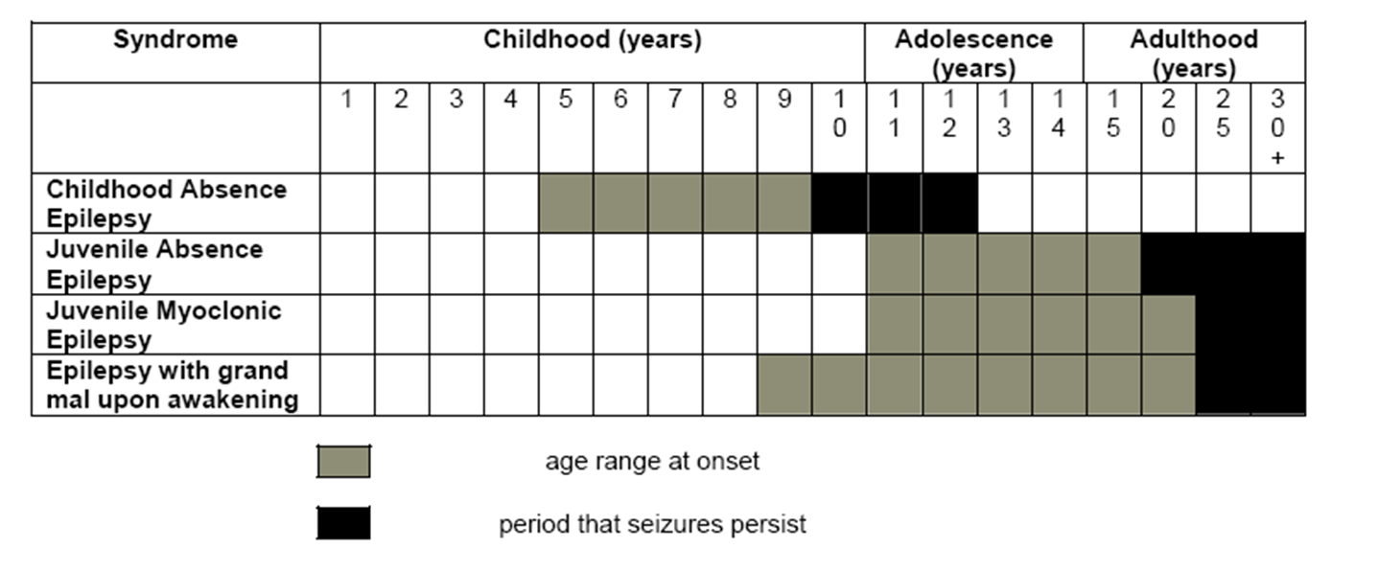
Epilepsy syndromes – age of remission

Slide 23
Other factors for increased risk of recurrence
Syndrome with high relapse rate (JME)
Mental retardation
Abnormal neurologic exam
Symptomatic cause (MRI epileptogenic lesion)

Slide 24
Case 3
27 year old woman who underwent right temporal lobectomy 12 months ago. Pathology confirmed mesial temporal sclerosis
Previously treated with 4 different AEDs and is currently on LTG and LEV
She has not had seizures since surgery and is planning a pregnancy in the future
Her routine EEG is now normal, other than right temporal slowing

Slide 25
Right temporal lobectomy. Seizure free for 2 years on 2 AEDs. Do you taper AED (s)?
Never
Taper one AED now and reassess
Taper one AED now then 2nd AED in 6 months
Taper both AEDs now
20

Slide 26
AED taper after epilepsy surgery
No randomized data
Intent for surgery is to cure seizures
  Theoretically eliminate the need for AEDs
  Seizure free rates: 50-80% depending in underlying cause/seizure type
These are patients who have been refractory for many years. After surgery may be the first time they have been completely seizure free
No all want to stop AEDs

Slide 27
Risks for recurrence after epilepsy surgery
> 30 years of age
Earlier taper
Persistent auras
Recurrence before taper attempt
Normal MRI
Long duration of epilepsy
Postop EEG abnormalities
Incomplete resection
More AEDs at time of surgery

Slide 28
Survey of “experts” at epilepsy centers
62% would only stop AEDs after 2 years of seizure freedom
Epilepsy & Behavior 10 (2007) 219–222

Slide 29
DF’s postoperative AED management plan
Only taper if seizure free
Continue an AED for at least 2 years after surgery
If on more than one AED, consider taper one at 12 months seizure free
Make decision on final AED taper after EEG normalizes (?ambulatory EEG?)
Only taper AED if patient is willing

Slide 30
Case 4
82 year old male
  April 9, 2014 - presented with focal motor seizure - left arm. Discovered to have a chronic right subdural hematoma. Started on levetiracetam
  April 17, 2014 - drainage of right subdural hematoma, Discharged two days later without problems. Prior to the surgery he had a few focal motor seizures.
  April 21, 2014 - admitted for new left arm weakness and was found to have focal motor seizures. cEEG was done with multiple electrographic seizures from the right hemisphere consistent with status epilepticus. Treated with levetiracetam, phenytoin and lacosamide. Discharged April 29, 2014 on these antiepileptic drugs

Slide 31
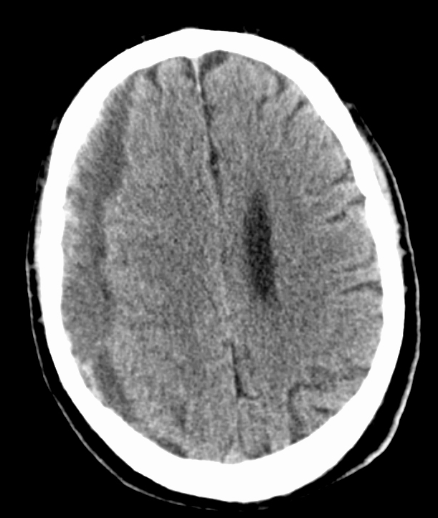
Case 4 cont’d
You are seeing him for the first time 3 months later
No seizures
What do you do with his AEDs?
  PHT 150 mg TID
  LCM 100 mg BID
  LEV 1250 mg TID

Slide 32
SDH (treated), focal status, 3 months seizure free.
Do you taper AED (s)?
Never
Taper one AED now
Taper one AED at 6 months
Taper one AED at 12 months
20

Slide 33
What did DF do?
DF plan
  Taper PHT now by 50 mg every week
  Taper LCM in another 3 months (if seizure free)
  Taper LEV at 1 year
Rationale
  Provoked seizures. Status related to surgical treatment
  Underlying etiology treated
  Elderly on polytherapy
Seizure free and off AEDs 15 months after SDH

Slide 34
Case 5
35 year old male is seen in follow up after hospitalization for convulsive status epilepticus
No prior history of seizures
Treatment in NSICU included:
  IV midazolam progressing to IV pentobarbital
  Status resolved after 7 days
  No identified etiology
Current AEDs: PHT, LEV, LCM, TPM
No seizures in past 2 months.
Complains of mild dizziness and sleepiness

Slide 35
Refractory status on 4 AEDs
Do you taper AED (s)?
Never
Taper one AED now
Taper one AED starting at 6 months
Taper one AED starting at 12 months
20

Slide 36
Case 6
45 year old male seen in follow up from NSICU admission
  Fell on ice, developed traumatic SAH, right temporal contusion
  cEEG in NSICU showed 10 right temporal electrographic seizures, right temporal LPDs that resolved after treatment with IV midazolam, LEV and LCM
You see him 3 months out and he is seizure free

Slide 37
cEEG seizures, TBI. 3 months seizure free
Do you taper AED (s)?
Never
Taper one AED now
Taper one AED starting at 6 months
Taper one AED starting at 12 months
20

Slide 38
AED taper seizures after acute neurologic injury
No data!
Theoretically all of these patients have a symptomatic cause for their seizures and should be at a higher risk for seizure recurrence
However, acute symptomatic causes may be different than remote symptomatic causes
  Epileptogenicity of acute neuro insults may decrease over time

Slide 39
Examples
Early seizures in TBI (less than 7 days) do not predict development of late seizures
  Prophylaxis with AEDs only decreases early seizure rate
Early seizures in stroke (less than 7 days) may not predict development of late seizures

Slide 40
DF recommendations - status
Status epilepticus – may need lifelong AEDs unless related to acute treated injury (SDH case)
  May consider decreased AED burden 6-12 months after status
Refractory status – probably need lifelong AEDs
  May not do any AED changes for 12 months, unless adverse effects

Slide 41
DF recommendations – acute seizures
Seizures after acute neurologic injury. May not need lifelong AEDs
  Consider taper of AEDs if on more than one at 6 months after injury
  Continue AEDs for at least 1 year
Electrographic seizures only on cEEG. May not need lifelong AEDs
  Consider taper at 6 months

Slide 42
Case 7
32 year old male with MR/DD and tonic seizures. EEG shows 3 Hz slow spike/wave. Seizures are daily and may be triggered by startle. May fall with seizures.
Current AEDs: FBM, VPA, LEV, ZNS and TPM
Has the VNS.
You are seeing him for the first time because his prior neurologist moved
Mom asks: “Is he on too many meds? He sleeps all the time”
Review of treatments indicate that addition of the above meds have made no difference in seizure frequency

Slide 43
LGS, daily seizures. On 5 AEDS
Would you taper AED (s)?
No way! Concern that seizures may increase
Would taper AEDs slowly with counseling about seizure increase
20

Slide 44
What did DF do?
Determined goal with mom. Seizure freedom is unlikely. Patient’s QOL at present is poor (sleepy, not interactive). Recognized high seizure burden.
Slow taper of AEDs (TPM, ZNS, LEV) over the course of about 2 years
Stayed on FBM, VPA
Seizure frequency unchanged, more interactive

Slide 45
Overtreatment of epilepsy
Adding on an AED is easy
Tapering an AED when adding starting another is not easy
We need to continually assess the need for each AED
DF’s rule of thumb – no more than 2-3 AEDs
Epilepsy Research 2002: Volume 52, Issue 1,

Slide 46
How to taper AEDs?
One AED at a time
Slower is better
  Can taper over 1-2 months for most AEDs
  Felbamate, phenobarbital, benzodiazepines should be tapered more slowly

Slide 47
Conclusions
Data for AED taper exist for epilepsies
  > 2 year seizure free
  Normal exam, MRI
  Normal EEG at time of taper
No randomized data for epilepsy surgery patients
  Let the epileptologist decide
No data for AED taper in acute neurologic conditions
  Consider taper of one AED at 6 months, complete discontinuation at 1 year?

Slide 48
Please return your ARS clickers

